Slide 1
Cloud Adoption Framework
Ready Phase
Notes:
© Anthony Clendenen
Tech Innovation Labs, 2020
anthony.Clendenen@gmail.com
https://anthonyonazure.com

Slide 2
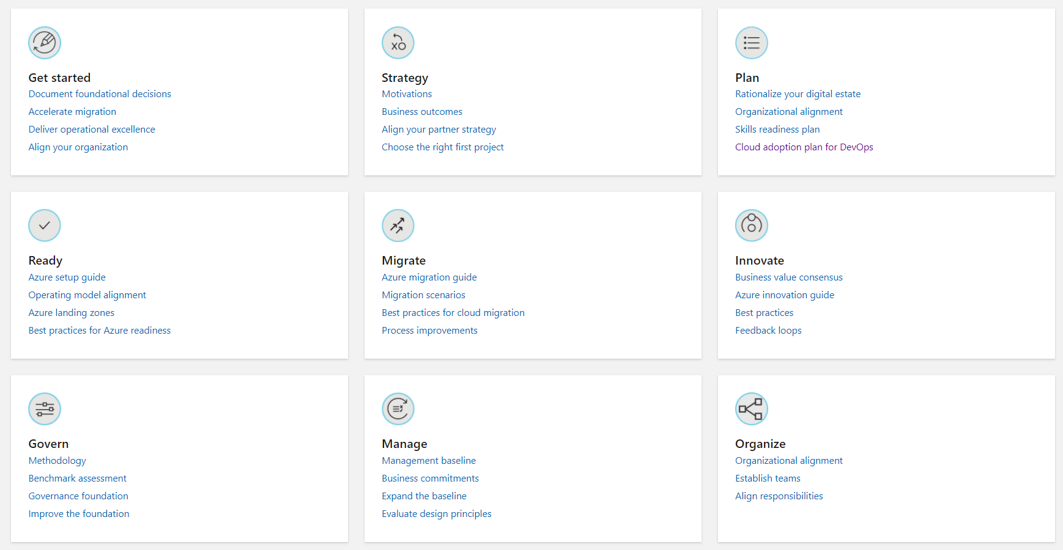

Slide 3
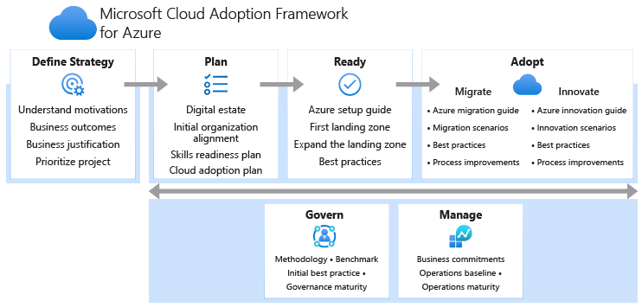

Slide 4

agenda
Organize resources: Set up a management hierarchy to consistently apply access control, policy, and compliance to groups of resources and use tagging to track related resources.
Manage access: Use role-based access control to make sure that users have only the permissions they really need.
Manage costs and billing: Identify your subscription type, understand how billing works, and see how you can control costs.
Plan for governance, security, and compliance: Enforce and automate policies and security settings that help you follow applicable legal requirements.
Use monitoring and reporting: Get visibility across resources to help find and fix problems, optimize performance, or get insight to customer behavior.

Slide 5
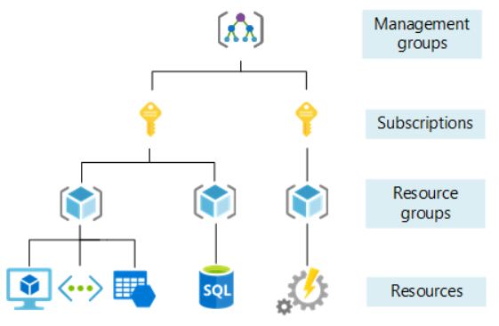
Organize Resources - Azure
Management groups: These groups are containers that help you manage access, policy, and compliance for multiple subscriptions. All subscriptions in a management group automatically inherit the conditions applied to the management group.
Subscriptions: A subscription groups together user accounts and the resources that were created by those user accounts. Each subscription has limits or quotas on the amount of resources you can create and use.
Resource groups: A resource group is a logical container into which Azure resources like web apps, databases, and storage accounts are deployed and managed.
Resources: Resources are instances of services that you create, like virtual machines, storage, or SQL databases.

Slide 6
Organize Resources - AWS
You can use resource groups to organize your AWS resources. Resource groups make it easier to manage and automate tasks on large numbers of resources at one time. This guide shows you how to create and manage resource groups in AWS Resource Groups.
Tags are key and value pairs that act as metadata for organizing your AWS resources. With most AWS resources, you have the option of adding tags when you create the resource

Slide 7
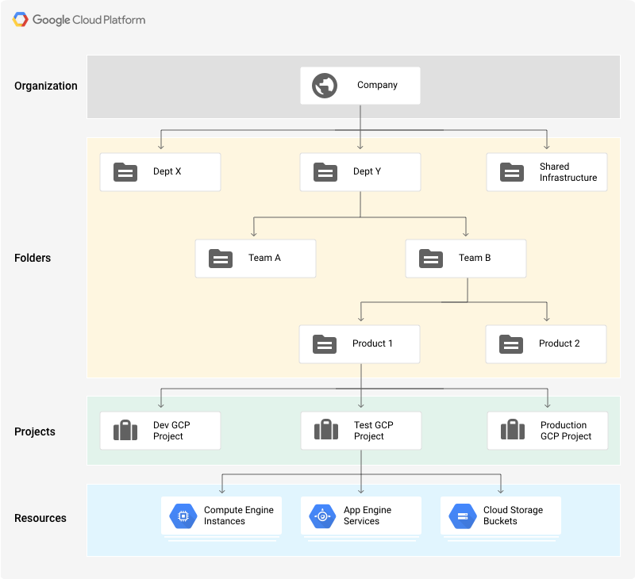
Organize Resources - GCP
The Organization resource represents an organization (for example, a company) and is the root node in the Google Cloud resource hierarchy
Folder resources provide an additional grouping mechanism and isolation boundaries between projects. They can be seen as sub-organizations within the Organization.
The project resource is the base-level organizing entity. Organizations and folders may contain multiple projects.

Slide 8
Naming standards
Every business has different organizational and management requirements. These recommendations provide a starting point for discussions within your cloud adoption teams.
A naming and tagging strategy includes business and operational details as components of resource names and metadata tags.
These conventions also help associate cloud usage costs with business teams via chargeback and showback accounting mechanisms.
The business side of this strategy ensures that resource names and tags include the organizational information needed to identify the teams. Use a resource along with the business owners who are responsible for resource costs.
The operational side ensures that names and tags include information that IT teams use to identify the workload, application, environment, criticality, and other information useful for managing resources.
Changing resource names can be difficult. Establish a comprehensive naming convention before you begin any large cloud deployment.
Notes:
Utilize the CAF Readiness Naming and Tagging tracking Excel template.
Understand provider limits and how they impact naming and tagging.

Slide 9

Naming resources
An effective naming convention assembles resource names by using important resource information as parts of a resource's name.
When you construct your naming convention, identify the key pieces of information that you want to reflect in a resource name. Different information is relevant for different resource types.
From a name, you be able to quickly identify the resource's type, its associated workload, its deployment environment, and the region hosting it.
Notes:
Example names: https://docs.microsoft.com/en-us/azure/cloud-adoption-framework/ready/azure-best-practices/naming-and-tagging#example-names

Slide 10

Resource tagging
When you apply metadata tags to your cloud resources, you can include information about those assets that couldn't be included in the resource name.
You can use that information to perform more sophisticated filtering and reporting on resources.
You want these tags to include context about the resource's associated workload or application, operational requirements, and ownership information.

Slide 11

Manage access
Managing access to cloud resources is an important part of your governance strategy and should be considered before deployment of any cloud resources.
When you plan your access control strategy, grant users the least privilege required to get their work done.
Role based access control (RBAC) is typically used to manage access.
Dealing with groups rather than individual users simplifies maintenance of access policies, provides consistent access management across teams, and reduces configuration errors.

Slide 12
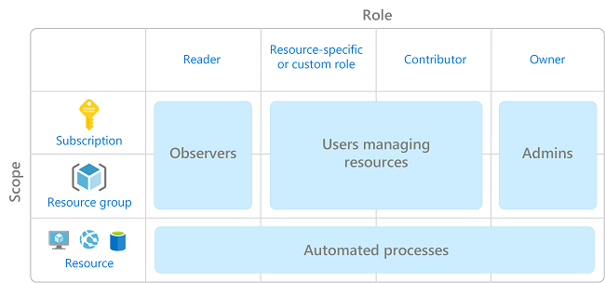
Manage access - azure
RBAC provides detailed access management of resources in Azure. It helps you manage who has access to Azure resources, what they can do with those resources, and what scopes they can access.
Custom and built-in roles combined with scope define access.

Slide 13
Manage access - aws

Slide 14
Manage access - gcp

Slide 15

Manage cost and billing
Cost management is the process of effectively planning and controlling costs involved in your business. Good cost management practices can help you plan with cost in mind. It can also help you to analyze costs effectively and take action to optimize cloud spending.
AWS, Azure, and GCP all provide tools to predict, monitor, control, and alert on cloud costs.
Notes:
Cost Management in Azure
Track Costs
Optimize Cloud Investment
Create and Management Budgets
Export Cost Data
Optimize Costs from Recommendations
Monitor Usage and Spending
Cost Management in AWS
AWS Budgets
AWS Cost Explorer
AWS Cost and Usage Report
AWS Cost Categories
Reserved Instance Reporting
AWS Cost Optimization
AWS License Manager
Manage your Amazon Elastic File System (EFS) Costs with AWS Budgets
Cost Management in GCP
Budgets and Alerts
Reports and Dashboards
Automated Budget Actions
Quotas
Billing API
Recommendations
Billing Exports
AWS Budgets gives you the ability to set custom budgets that alert you when your costs or usage exceed (or are forecasted to exceed) your budgeted amount.
AWS Cost Explorer has an easy-to-use interface that lets you visualize, understand, and manage your AWS costs and usage over time.
The AWS Cost & Usage Report contains the most comprehensive set of AWS cost and usage data available, including additional metadata about AWS services, pricing, and reservations (e.g., Amazon EC2 Reserved Instances (RIs)).
AWS Cost Categories enables users to define category rules to map and categorize costs using billing dimensions such as accounts and tags. For example, customers can map specific accounts and tags to multiple projects and track costs based on them.
Set budgets to closely monitor your costs and alert stakeholders through email or Cloud Pub/Sub when exceeding defined budget thresholds.
Get at-a-glance views of your current cost trends and forecasts with intuitive reports in the Cloud Console. Create custom dashboards for your teams with Data Studio.
Configure automated actions using programmatic budget notifications to throttle resources and cap costs to prevent unexpected activity from affecting your budgeted cloud spend.
Set quota limits to proactively control your spend rate and prevent unforeseen spikes in usage
Programmatically access and manage your billing accounts with Billing APIs.
View intelligent recommendations for optimizing your costs and usage. Easily apply these changes for immediate cost savings and greater efficiency.
Export detailed usage and cost data automatically to CSV or JSON files stored in Cloud Storage or export directly to BigQuery so that you can use Data Studio or your preferred analytics tool for further cost analysis.

Slide 16
Plan Governance security and compliance
As you establish corporate policy and plan your governance strategies, you can use tools and services to enforce and automate your organization's governance decisions.
Improper governance is the #1 reason cloud projects fail.
When strong governance and enforcement are not in place it can cause security concerns.
Proper governance should allow you to meet compliance standards.
Governance is the cornerstone of a good cloud project.
Before you start your governance planning, use the Governance Benchmark tool to identify potential gaps in your organization's cloud governance approach.
Notes:
When strong governance and enforcement are not in place it can cause security concerns. Companies must address oversight challenges so risks are known and can be minimized.

Slide 17

Establish monitoring and reporting
Cloud providers offers many services that together provide a comprehensive solution for collecting, analyzing, and acting on telemetry from your applications and the cloud resources that support them.
Each provider offers a different set of services for monitoring and reporting.
Monitoring and reporting is a critical part of your cloud adoption plan.

Slide 18
First landing zone
A landing zone is the basic building block of any cloud adoption environment. The term landing zone refers to a logical construct capturing everything that must be true to enable the desired cloud adoption.
Scope: A fully functional landing zone considers all platform resources that are required to support the customer's adoption needs.
Refactoring: A fully functional landing zone is the final deliverable of any iteration of the Cloud Adoption Framework's Ready methodology. During each iteration, the codebase that defines the landing zone will be refactored or expanded. After refactoring, the landing zone may be modified or redeployed to allow for new cloud adoption needs.
Goal: The goal of the landing zone approach is to create a common set of consistent platform implementations. Those consistent implementations must be in place to ensure that your applications have access to requisite components when deployed. Each landing zone iteration must consequently be designed and deployed in accordance with the requirements of the cloud adoption plan and the subscription design strategy.

Slide 19
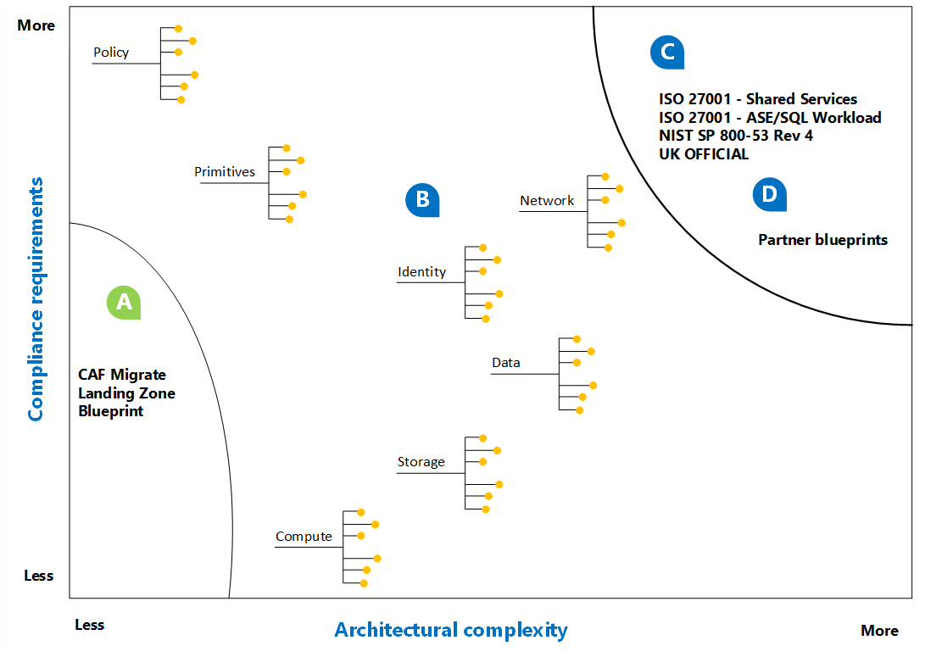
Expanding the landing zone
Notes:
A. Start with code to produce consistent, repeatable landing zones. If you're comfortable with refactoring (or refining the code and infrastructure) as you learn, start with a lightweight code base, like the Cloud Adoption Framework's Migrate landing zone blueprint. This approach accelerates adoption success and creates hands-on learning opportunities. However, this type of initial landing zone is not designed for sensitive data or mission-critical workloads, without additional refactoring.
B. As adoption grows and requirements become more clearly identified, the adoption and platform teams will refactor landing zones based on what they learn. The process of expanding your landing zones prepares environments for more complex compliance or architecture requirements. Expand the landing zone provides decision guides and links to best practices to guide refactoring efforts. Expanding the landing zone can aid in meeting security, operations, and governance requirements.
C. Some cloud adoption plans are governed by external compliance requirements. To reduce the burden of meeting these requirements, Azure provides a few sample Azure Blueprints. Some of the samples can be added to your first initial blueprint. Other samples also include a specific implementation that can serve as a first landing zone.
D. When a partner provides ongoing managed services or is contracted to deliver on the adoption plan, they will typically provide their own landing zone. Using a partner landing zone could accelerate adoption efforts and ensure consistent operational management requirements. However, give additional consideration to internal governance and security requirements to ensure alignment.

Slide 20
Q&A

